Slide 1
BJIT Academy
By Takitazwar Parthib

Slide 2
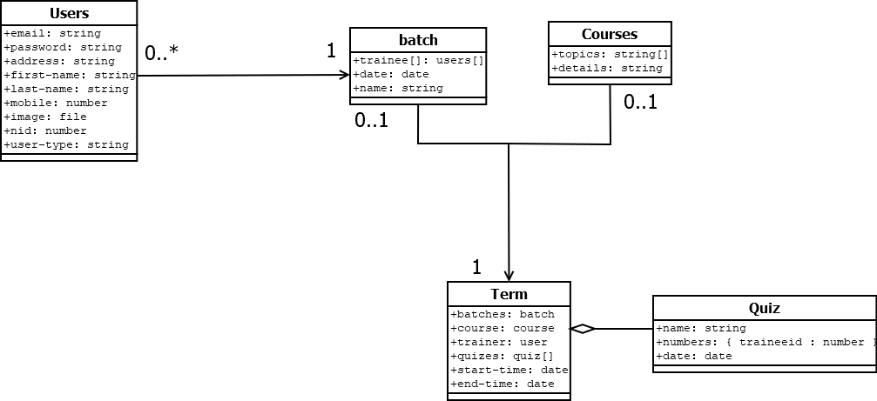
Class Diagram

Slide 3
Admin Functionality (User)
Can create two type of users
Can add Picture of employee
Can Edit and Delete Employee
If User delete, It is also deleted from Batch
Can add Topics to Trainer Profile

Slide 4
Admin Functionality (Batch)
CRUD Operation on Batch
Add Trainee to batch
Delete Trainee from batch
Paginated UI
Can Search Batch

Slide 5
Admin Functionality (Course)
Crude operation on Course
Add, Delete Topics from course
If Course is deleted, it is also deleted from Term
Term Trainer can only be added if Course is added first

Slide 6
Admin Functionality (Term)
Common Database for Trainer, Batch and Course
Can Add, remove Batch
If course is removed, Trainer is vacated
Only those trainer which has topic expertise will be offered to be added

Slide 7
Trainer (Term)
Can check Terms assigned to him only
Can add Quiz to term
Can give marks to trainers

